Slide 1
LENDING CLUB CASE STUDY
By: Zeba Firdows & Suman Ghosh

Slide 2
Business Objective
Lending club, Founded In 2006, Is A Peer-To-Peer Lending Platform Based In San Francisco. It Connects Borrowers With Individual Investors, Offering Personal And Business Loans. Borrowers Apply Online, And Lending club Assesses Their Creditworthiness. Investors Can Fund Loans And Earn Interest, While Borrowers Access Financing. The Company Has Played A Role In Reshaping The Lending Landscape.
This company is the largest online loan marketplace, facilitating personal loans, business loans, and financing of medical procedures. Borrowers can easily access lower interest rate loans through a fast online interface
If one. Is able to identify these risky loan applicants, then such loans can be reduced thereby cutting down the amount of credit loss. Identification of such applicants using EDA is the aim of this case study.

Slide 3
Business Goal
The aim is to identify patterns which indicate if a person is likely to default, which may be used for taking actions such as denying the loan, reducing the amount of loan, lending (to risky applicants) at a higher interest rate, etc….
The aim is to identify patterns which indicate if a person is likely to default, which may be used for taking actions such as denying the loan, reducing the amount of loan, lending (to risky applicants) at a higher interest rate, etc….
In other words, the company wants to understand the driving factors (or driver variables) behind loan default, i.e. the variables which are strong indicators of default. The company can utilise this knowledge for its portfolio and risk assessment.

Slide 4
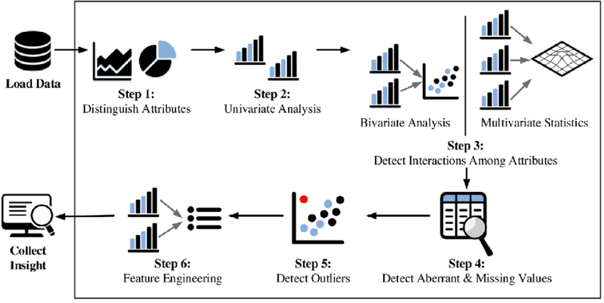
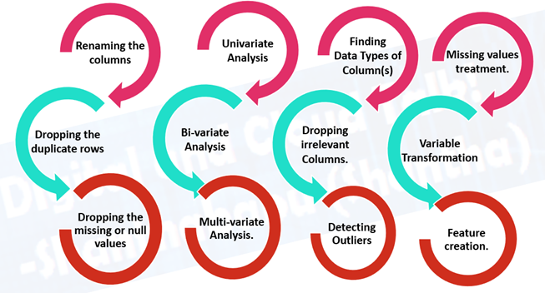
The Analysis is divided into 3 parts
Data Understanding
Data Preparation
Outlier Detection
Exploratory Data Analysis (EDA)
Data Visualization
Descriptive Statistics
Missing Values Handling
Data Profiling
Data Cleaning
Feature Selection
Advanced Visualization

Slide 5
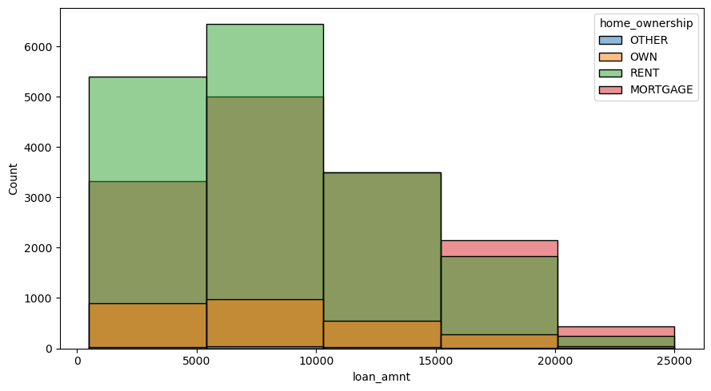
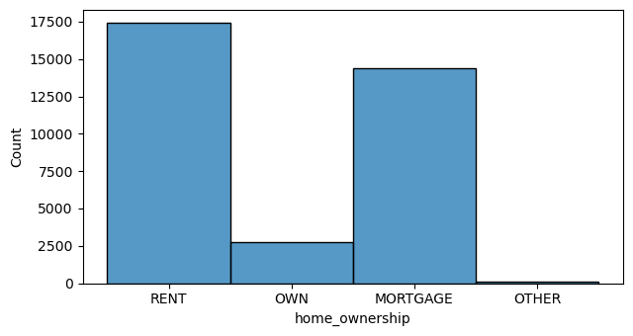
Loan Amount & Home Ownership
Loan Amount
From The Above Graph We Observed That The Maximum Loan Amount Is 25000 Majority Of The People Taken The Loan Up To 10000 Majority Peoples Are From Rent
Home Ownership
From The Above Plot Rent And Mortgage People Are High And Own And Other Less & 17500 Peoples Are From Rent And Mortgage

Slide 6
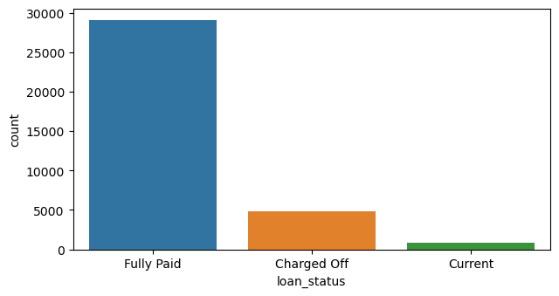
Loan Status
In Loan Status We Have 3 Groups
Fully Paid
Charged Off
Current
From The Above Plot Most Of The Applicants Are Fully Paid Where As Remaining Are Very Less Current Status Is Very Less
Loan Status Also Plays Important Role To Find The Loan Applicants Is Default Is Or Not

Slide 7
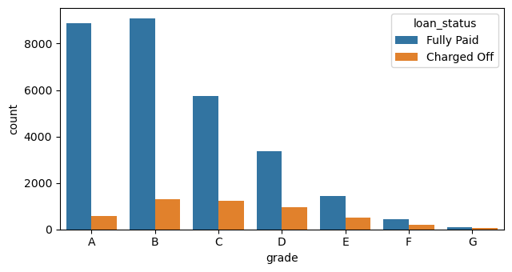
Grade
This Plot Explains That While Paying The Loan, Individuals' Grades Have Been Calculated According To The Payment Of The Loan. A Grades Indicate That The Majority Of Them Have Fully Paid, And There Are Very Few Charged Off. In F And G Grades, There May Be A Chance Of Default."

Slide 8
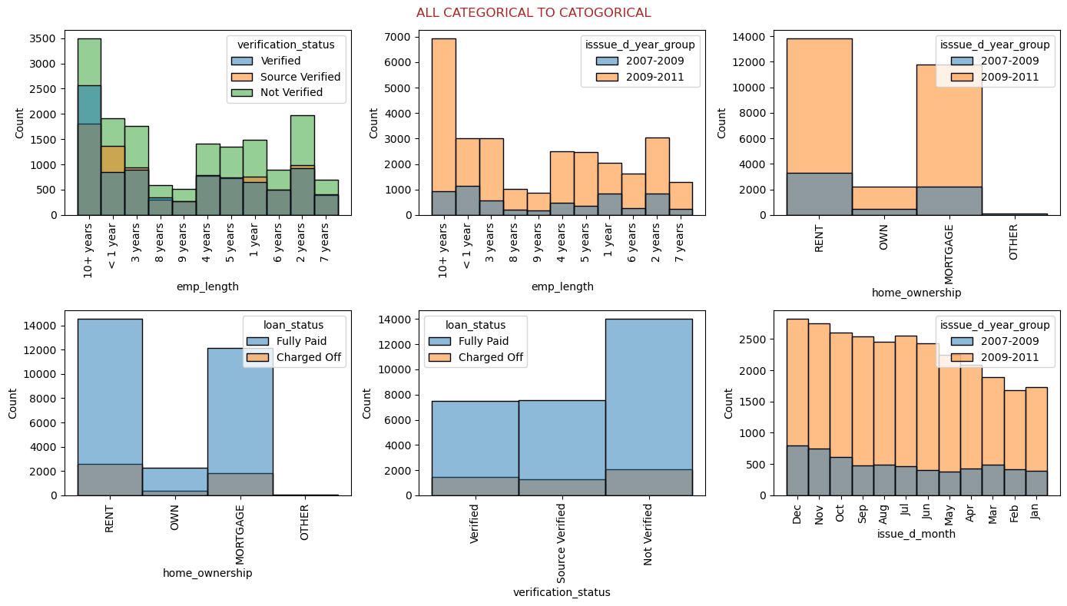
Emp_length & Home_ownership & Issue_d_year & Verification_status

Slide 9
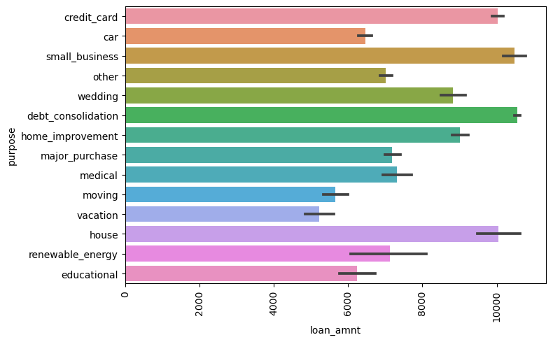
Purpose And Loan Amount
From The Above Plot There Are Only Few Members Who Has Taken The Loan Amount Up To 10000 They Are:
Credit_Card
Small_Business
House
Debt_Consolidation
Some Of Them Are Taken Very Less Loan Amount Depending Upon Them
Here Are List of Purpose
Car
Other
Wedding
Home Improvement
Medical
Moving etc…..

Slide 10
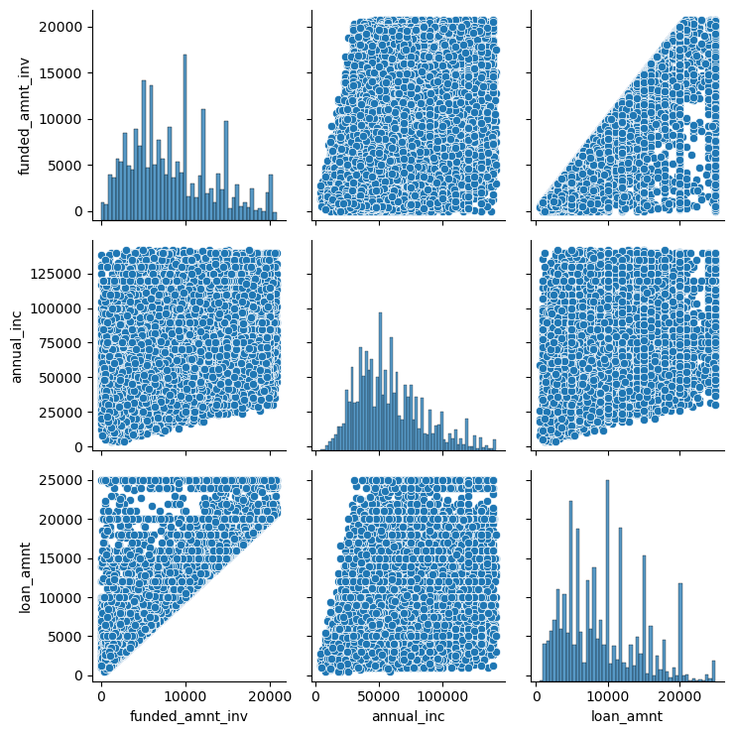
Multivariate Analysis
This plot explains about the pair relation ship between the variables
Funded_amnt_inv
Annual_inc
Loan_amnt

Slide 11
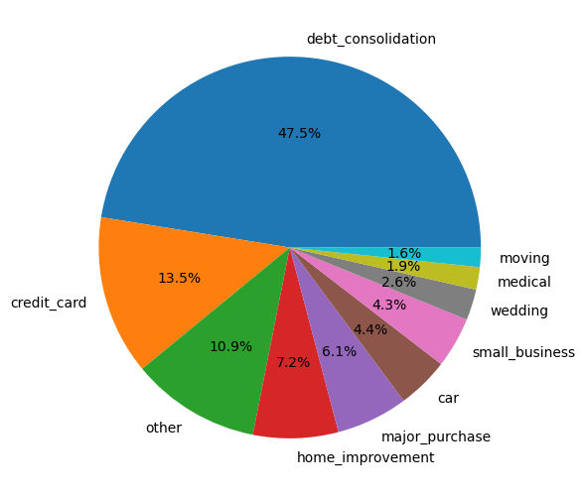
Purpose on which maximum loan is taken
Important Features
Debt_consolidation
Credit_card
Other
Home_improvement

Slide 12
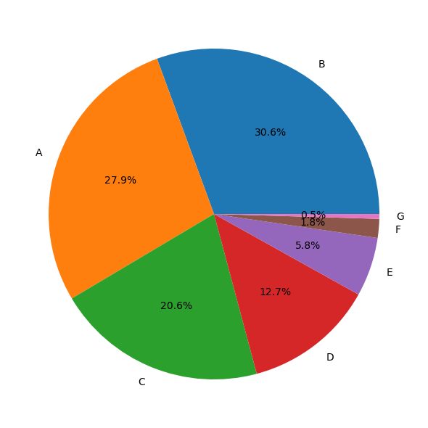
RANKING OF GRADE HOW THEY ARE PERFORMING
Top 4 Grades Which Play Major Role Which Prevent From Default The Loan They Are:
A
B
C
D
The Grade E Also Important But Very Less F And G May Effect To Our Analysis In Which There Are High Chance To Get Those Who Taken Loan May Go In Default Section

Slide 13
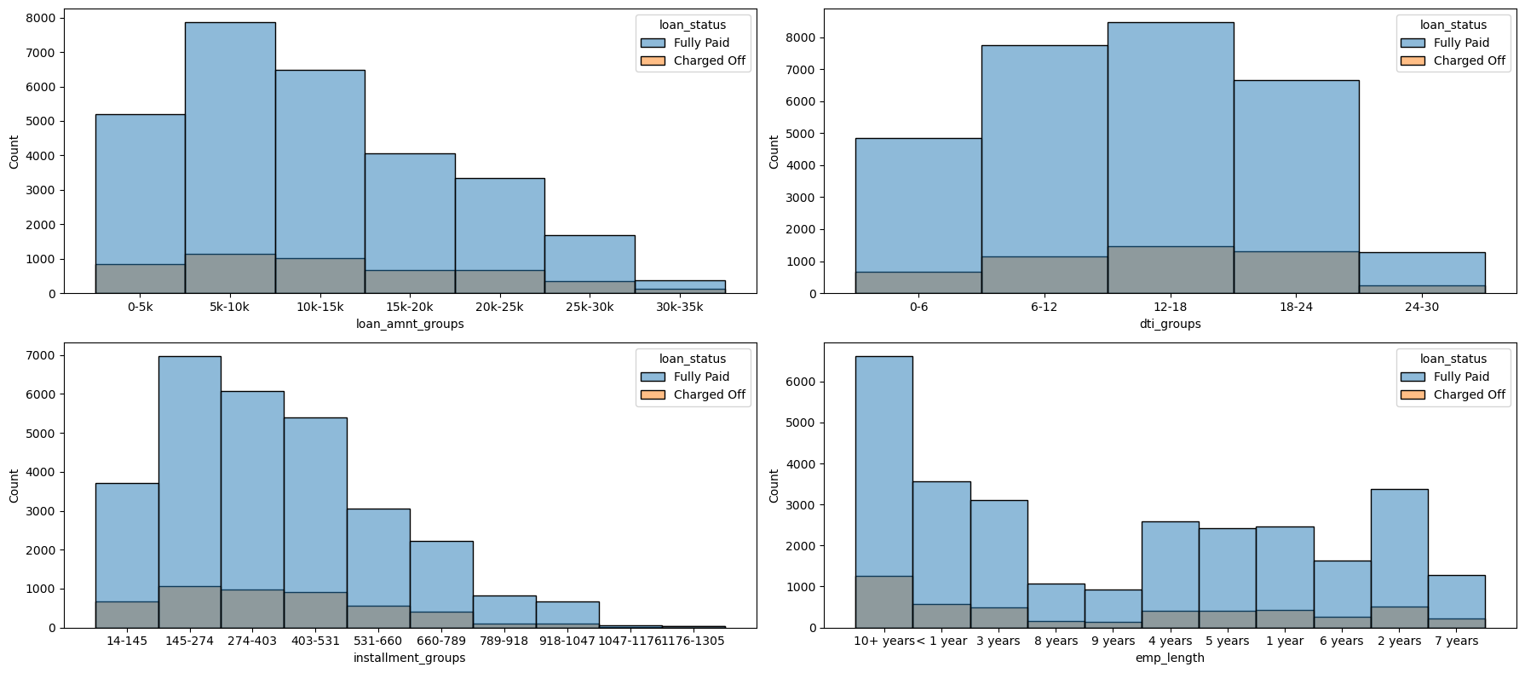
Loan amount installment groups & Dti_groups

Slide 14
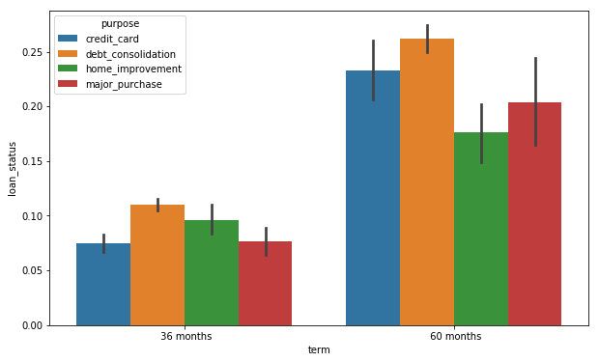
Term And Purpose
From the above Histogram we observed that we have visualized the data among term & loan status including the purpose of the loan
The term of the loan has 36 months and 60 months
From the 36 months the debt_consolidation is high then home_improvement then credit card
From the 60 months the debt_consolidation is high then credit_card in this term the major_purpose is increased 15 % as compared to to 36 month

Slide 15
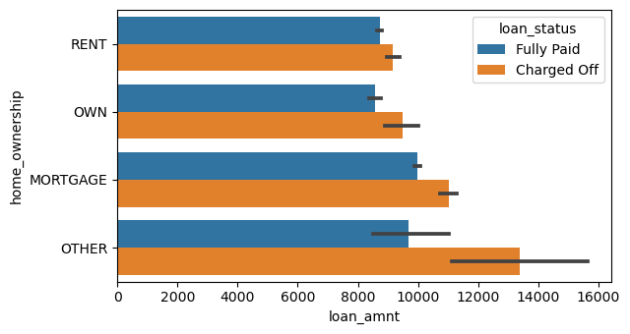
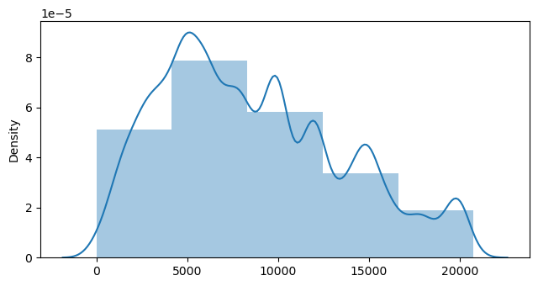
Funded Amount &Loan Amount
From the above one is funded amount and another one is loan amount
The funded amount is slightly right skewed and the average shows 5000 and there is slightly increasing and decreasing from 10000 to 20000
Where as from another plot the loan if up to 16000.mainly all them are maintaing equally

Slide 16
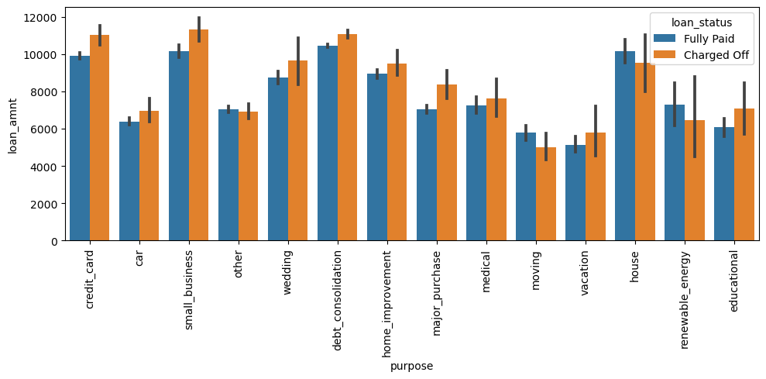
Purpose And Loan Amount
As They Have Taken The Loan Fully Paid Is More But The Problem The In All The Cases In Which The Loan Is Taken Charged Of Is More Where Ever You Observe The Charged Off Is More There Might Be Chance Of Getting Default

Slide 17
recommendations:
Reduce The Interest Rate And Check The Background Verification Of Those Who Have Applied For Loan Should Have Good Cibil Score & Monthly Income He/She Should Be Verified.
Decrease The Loan Amount For Which Those Who Have Rent Mortgage House
Give The Loan For Only 36 Months
We Notice That Out Of All The Data There Are Less Number Of Charged Off
Most Of The Taken House Who Have Rent House And Mortgage House
To Consider Most Of The Loans Are Fully Paid
If We Compare To Loan Amount Vs Purpose Most Of The Cases There Are Equally Paid And Charged Off
Those Who Have High Annual Income They Have Taken Loan
Overall Less Charged Off
For One Column Data Loan Status And Purpose Then We See That Debt Consolidation Has Fully Paid And Charged Off Is Very Less
Low Annual Income Has Low Funded Amount

